Slide 1
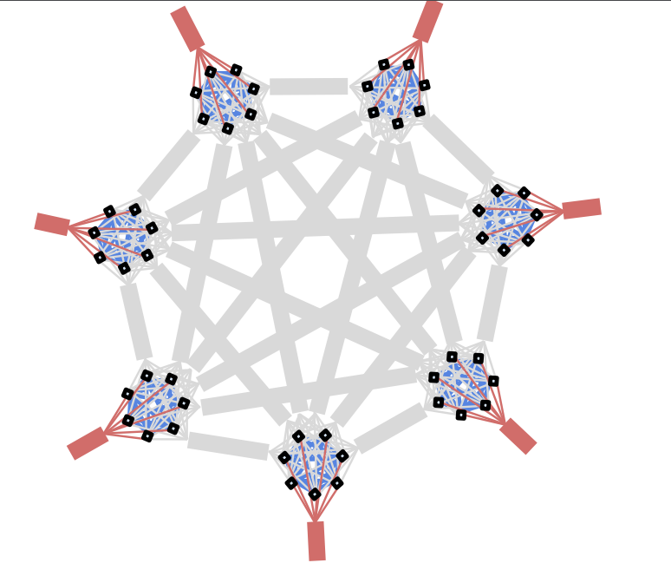
Aquila: A unified, low-latency fabric for datacenter networks
Dan Gibson, Hema Hariharan, Eric Lance, Moray McLaren, Behnam Montazeri, Arjun Singh, Stephen Wang, Hassan M. G. Wassel, Zhehua Wu, Sunghwan Yoo, Raghuraman Balasubramanian, Prashant Chandra, Michael Cutforth, Peter Cuy, David Decotigny, Rakesh Gautam, Alex Iriza, Milo M. K. Martin, Rick Roy, Zuowei Shen, Ming Tan, Ye Tang, Monica Wong-Chan, Joe Zbiciak, Amin Vahdat
Google

Slide 2
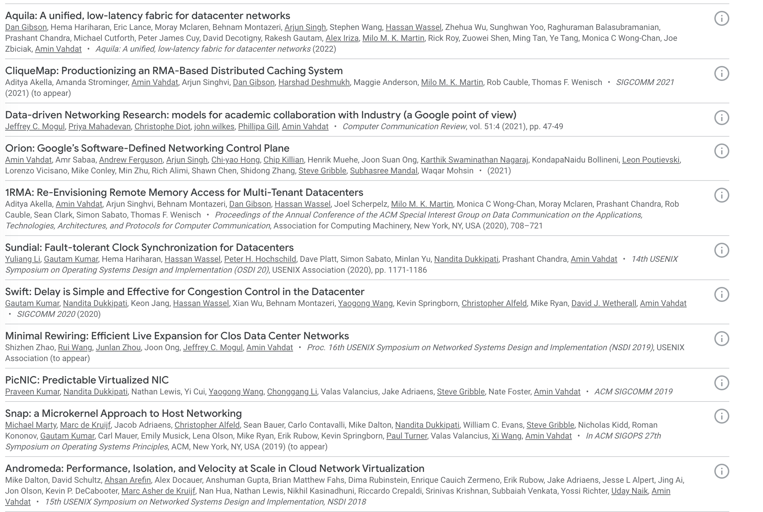
Google’s history

Slide 3
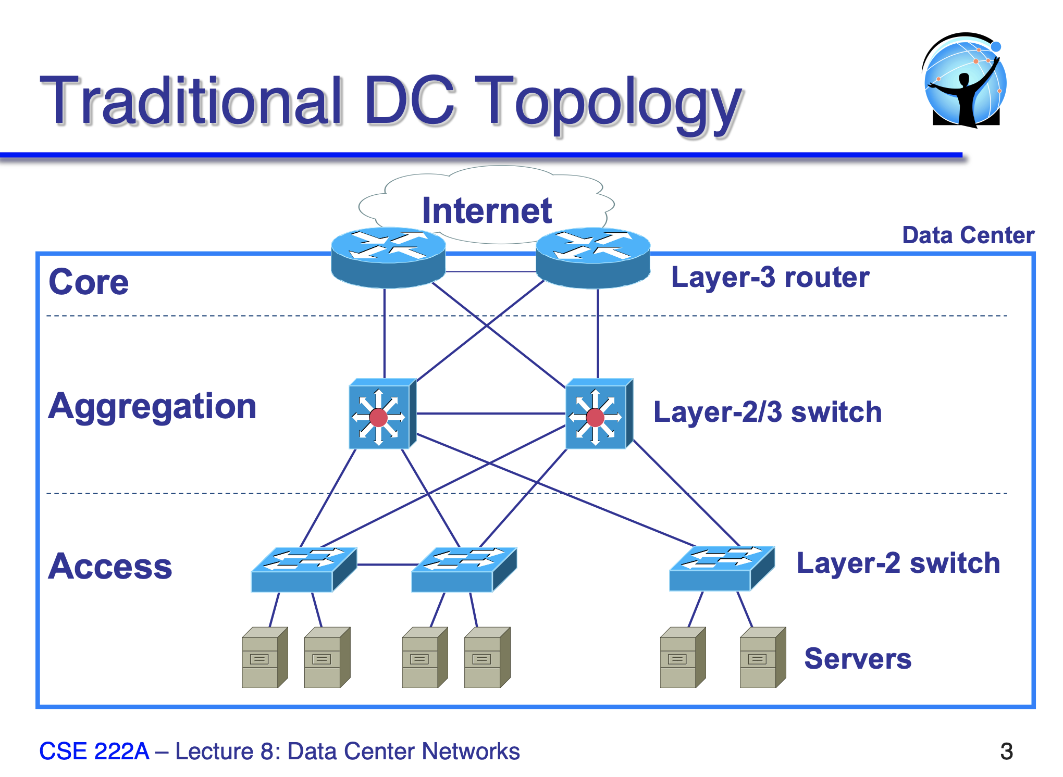
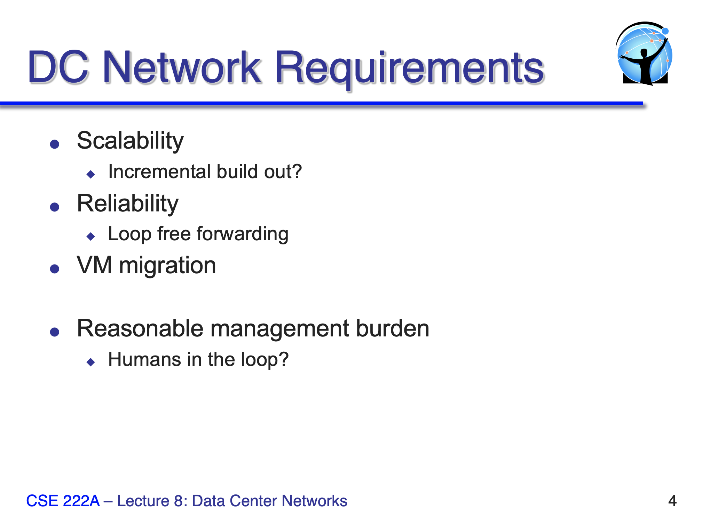
Datacenter Network (DCN) 101

Slide 4
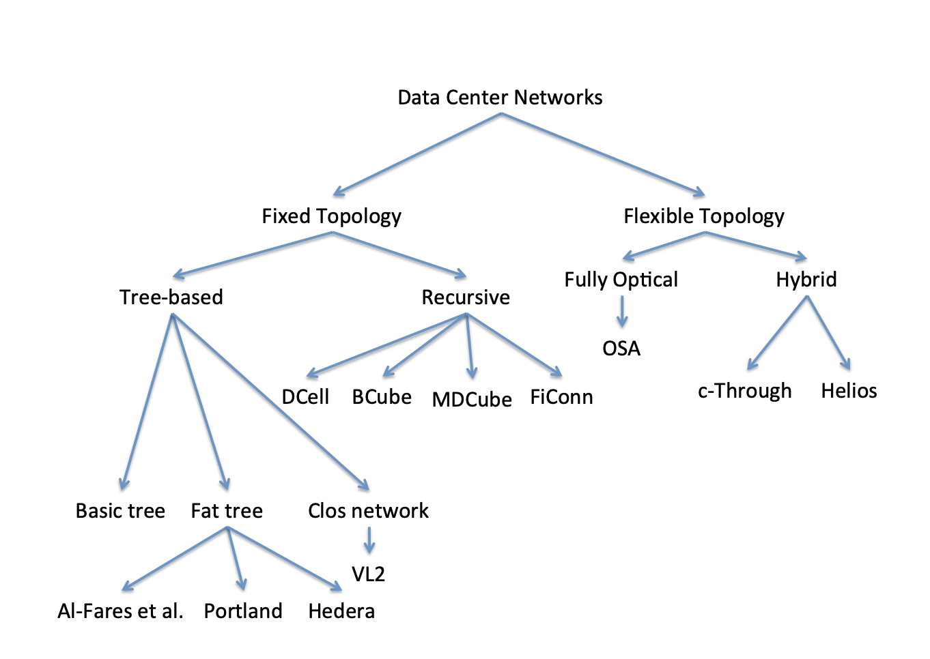
DCN Considerations
Topology
Scalability
Incremental deployment
Cabling complexity
Failure tolerance
Routing
Maximizing bandwidth
SDN Complexity
Transport
Congestion control
Low Latency

Slide 5
Motivation
Need for ultra-low latency:
Tightly-coupled DC workloads
Low-latency RDMA
Resource disaggregation
Goal: RDMA co-existing with TCP/IP but without performance impact
RDMA on L3 – too slow
RDMA on L2 – but ethernet makes sharing difficult
So why not rebuild L2 to support both?
Notes:
The need for backward compatibility combined with challenges in deploying niche "bag on the side" networks threatens a new ossification in datacenter networking and distributed systems where we are left with programming to the lowest common denominator of TCP transports and commodity Ethernet switches with associated latency, CPU efficiency, and isolation limitations.

Slide 6
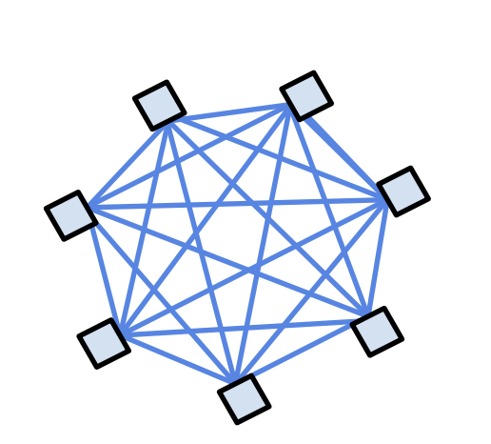
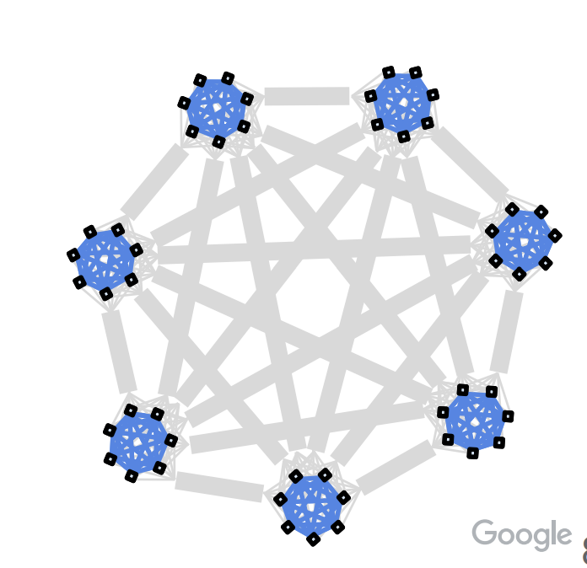
Aquila
Clique-based architecture
1-2k network ports per clique
Plugs into the traditional clos network
New capabilities within the Clique
Robust RDMA
Predictable, low-latency communication
Device disaggregation
Support for ML primitives
Traditional IP-based transport between Cliques
Sufficiently larger (than a rack) for many apps

Slide 7
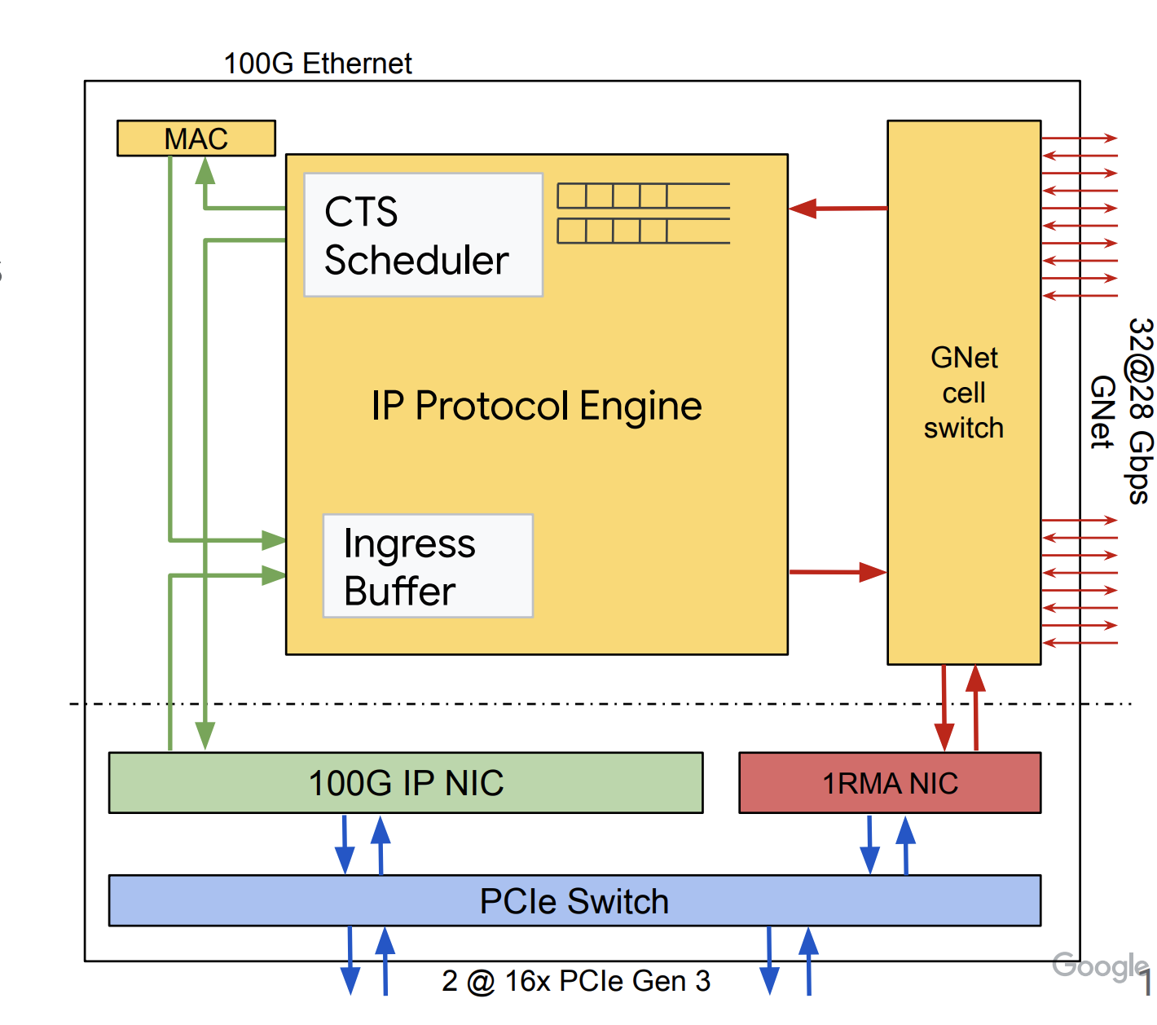
Aquila: Design goals
Cost-effective
Single, replicated silicon component
Switch in the NIC: ToR-in-NIC (TiN) chip
Connections within and across Cliques
NIC + medium-radix switch
Notes:
Combining NIC and ToR into the single TiN chip was a less costly path to innovation than separate NIC and switch ASIC programs

Slide 8
Aquila: Design goals
Cost-effective
Ultra low-latency
Cell-based communication – much smaller than packets
Shallow-buffering
Near lossless delivery – with end-to-end solicitation
Notes:
Combining NIC and ToR into the single TiN chip was a less costly path to innovation than separate NIC and switch ASIC programs

Slide 9
Aquila: Design goals
Cost-effective
Ultra low-latency
Unified fabric
Both legacy and RDMA traffic
New Layer-2 protocol GNet
Bake RDMA into GNet, instead of overlay
Notes:
Combining NIC and ToR into the single TiN chip was a less costly path to innovation than separate NIC and switch ASIC programs

Slide 10
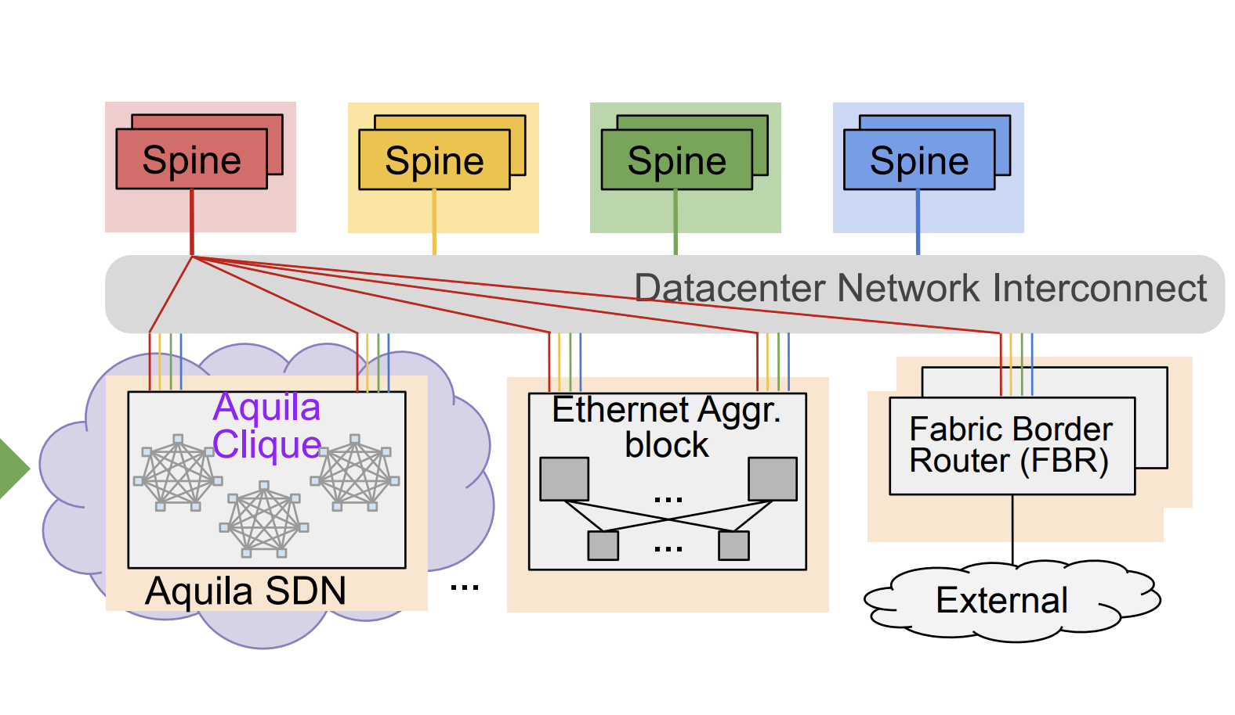
Aquila: Design goals
Cost-effective
Ultra low-latency
Unified fabric
Co-existence in the larger DCN
Plugs externally with Ethernet
Self-contained SDN controller
Clique-locality in Job scheduling
Notes:
Combining NIC and ToR into the single TiN chip was a less costly path to innovation than separate NIC and switch ASIC programs

Slide 11
Overview
Hardware design and layout
SDN Infrastructure & Challenges
Results
Limitations/Discussion

Slide 12
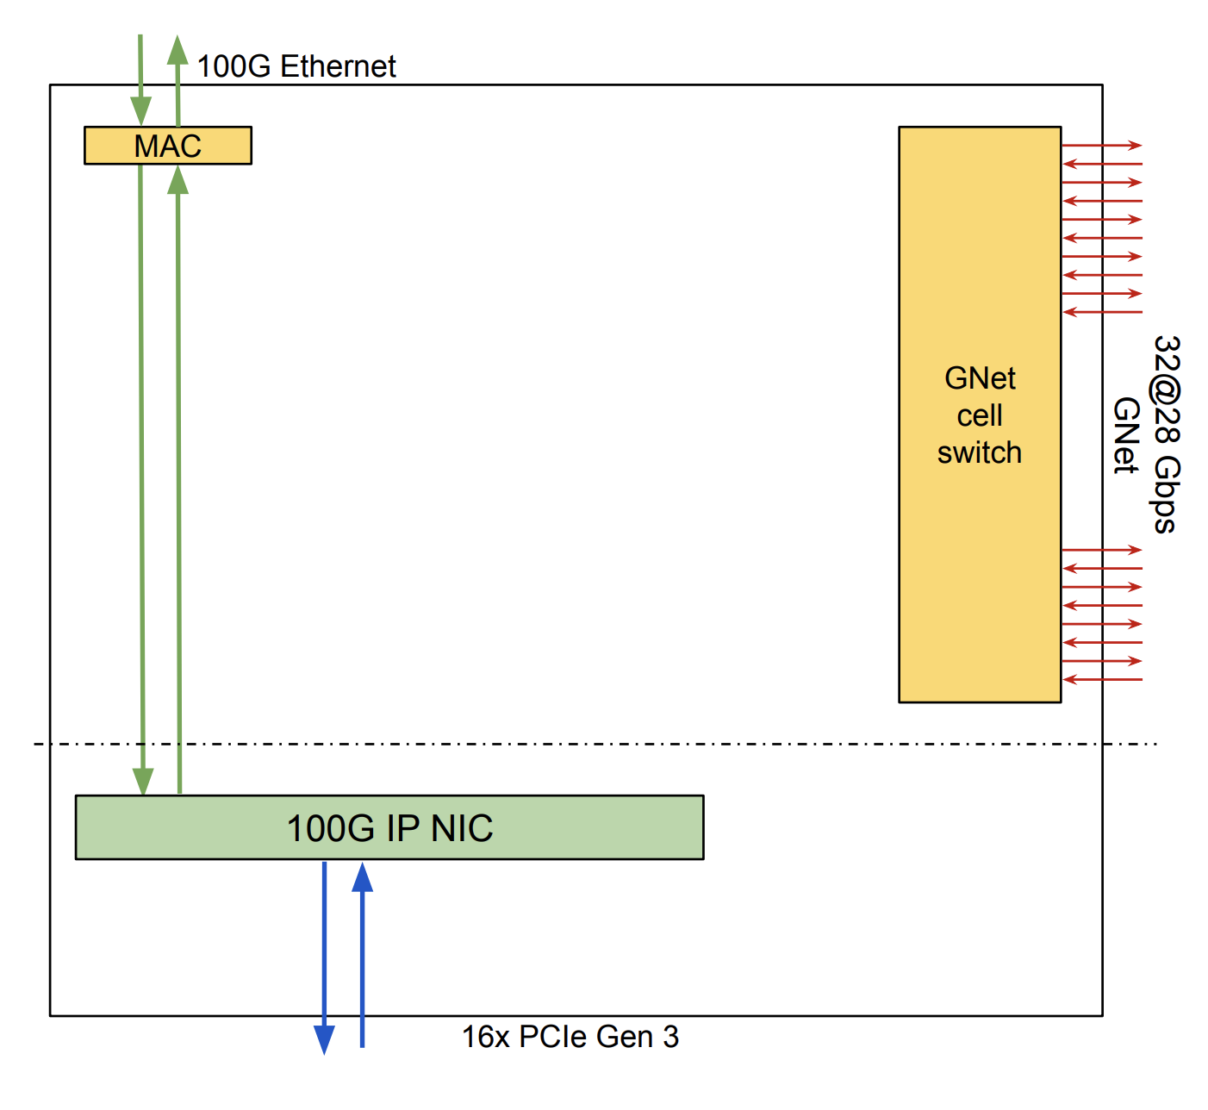
TiN Chip
50-port Cell Switch
24 pod-local links (copper)
8 inter-pod links (optical)
18 internal (IP, RDMA, etc.)
32 VCs with FIFO per port
Credit-based Flow Control
Isolated buffers/credits

Slide 13
TiN Chip
GNet L2 protocol on all links
Cell size 16 to 160B
8B header
16-bit source and destination address
Cell type, VC, hop count, CRC, etc.
Adaptive routing for most traffic
Minimal & Non-minimal routes
Randomized, weighted route picking
Deterministic only for ordered traffic

Slide 14
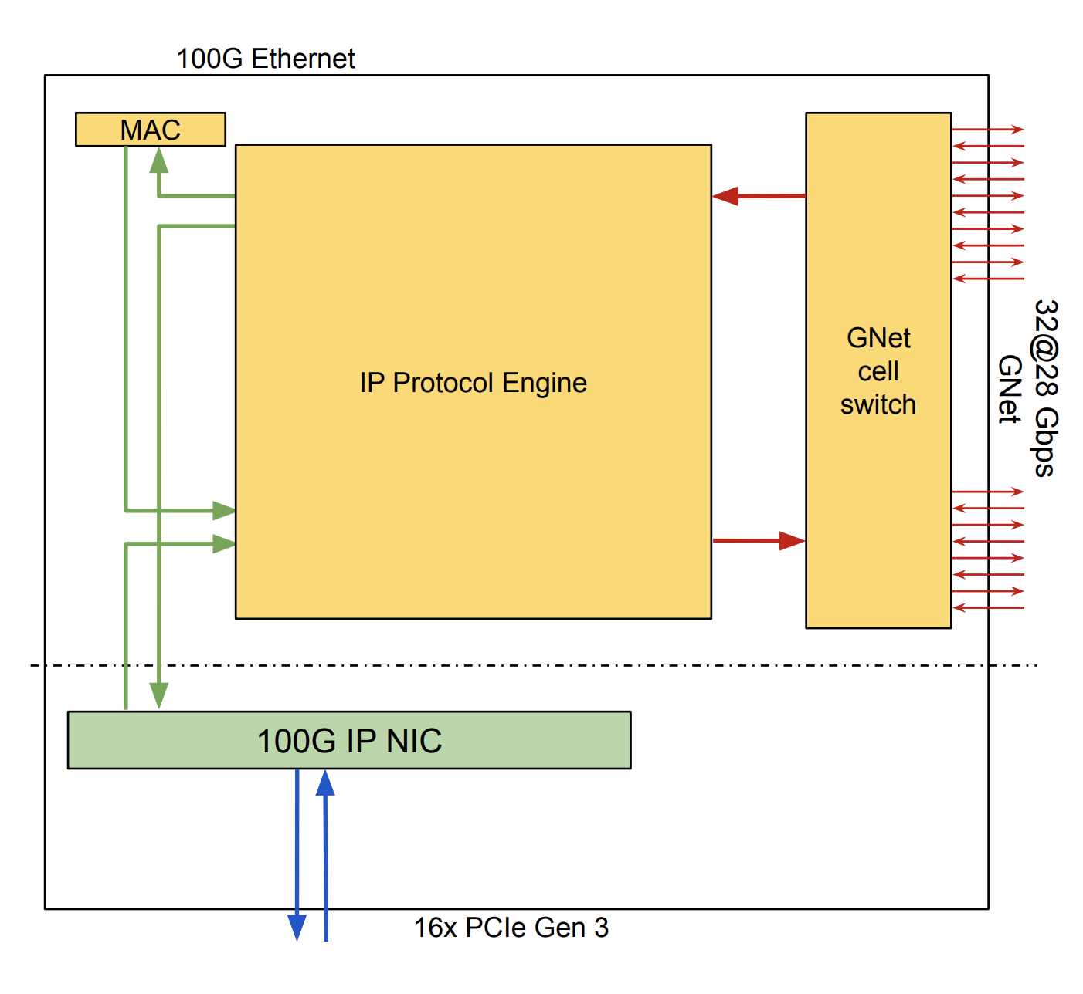
IP over GNet
IP to GNet translation
Sources: NIC & External Ethernet
Split IP packets to cells
Gather then back at destination
L3 to L2 address translation

Slide 15
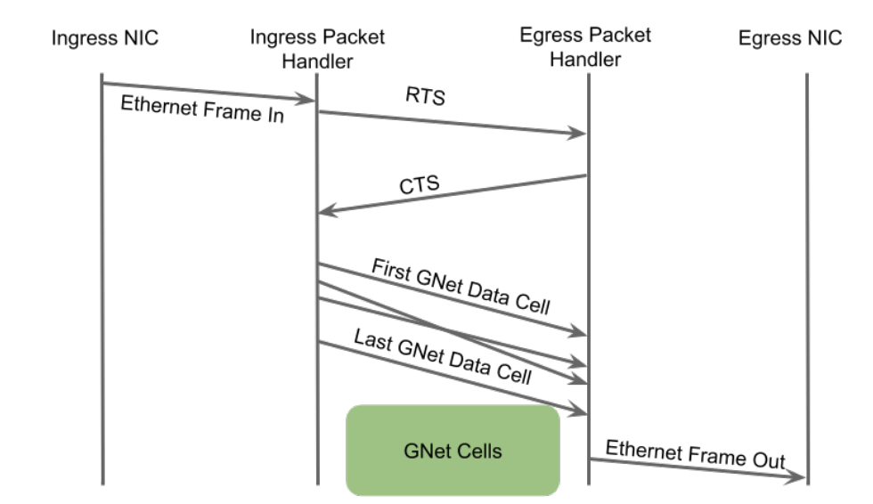
IP over GNet
Admission control
Solicitation with RTS/CTS
On high-priority VC
Routed deterministically
RTS order defines packet order
Packet Drops/ECN at ingress based on RTS queue thresholds
CTS window can be adaptively controlled to ease congestion
Helps with incast at receiver/RTS path but what about other points in the fabric?

Slide 16
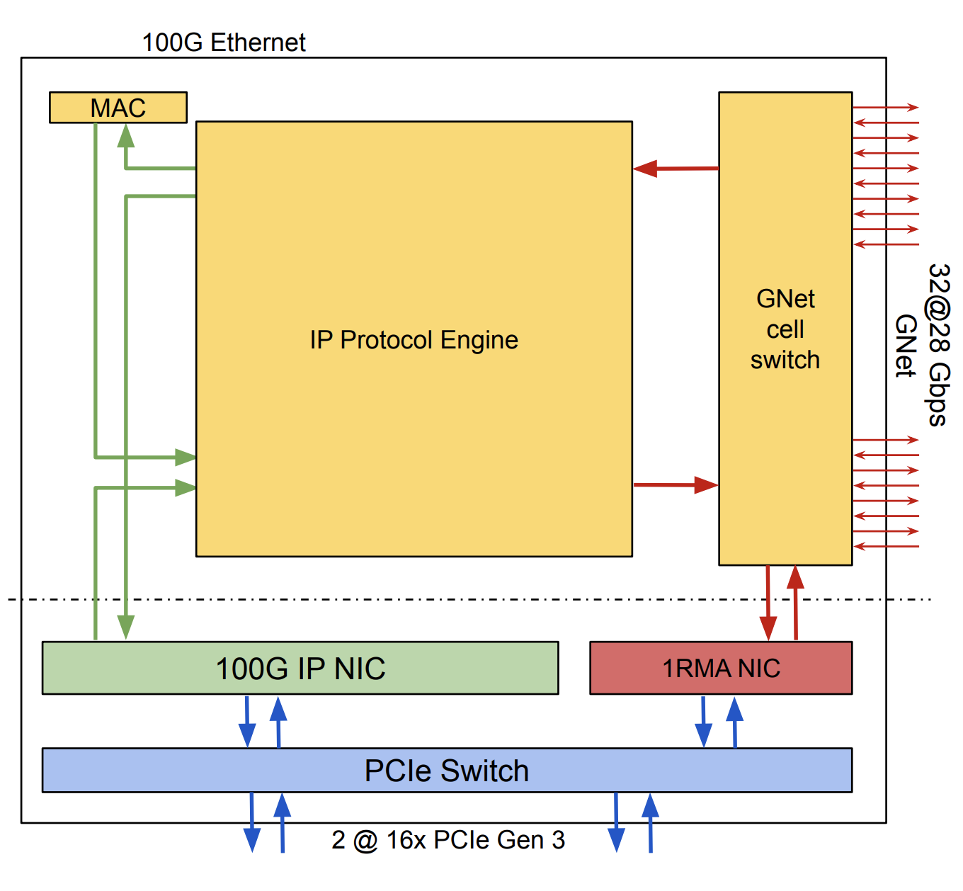
RDMA over GNet
1RMA – Google’s RDMA variant
Not layered on IP anymore
First-class cell types: Req, Resp
Similar treatment as RTS/CTS
Gets separate VCs
No HOL-blocking by IP traffic

Slide 17
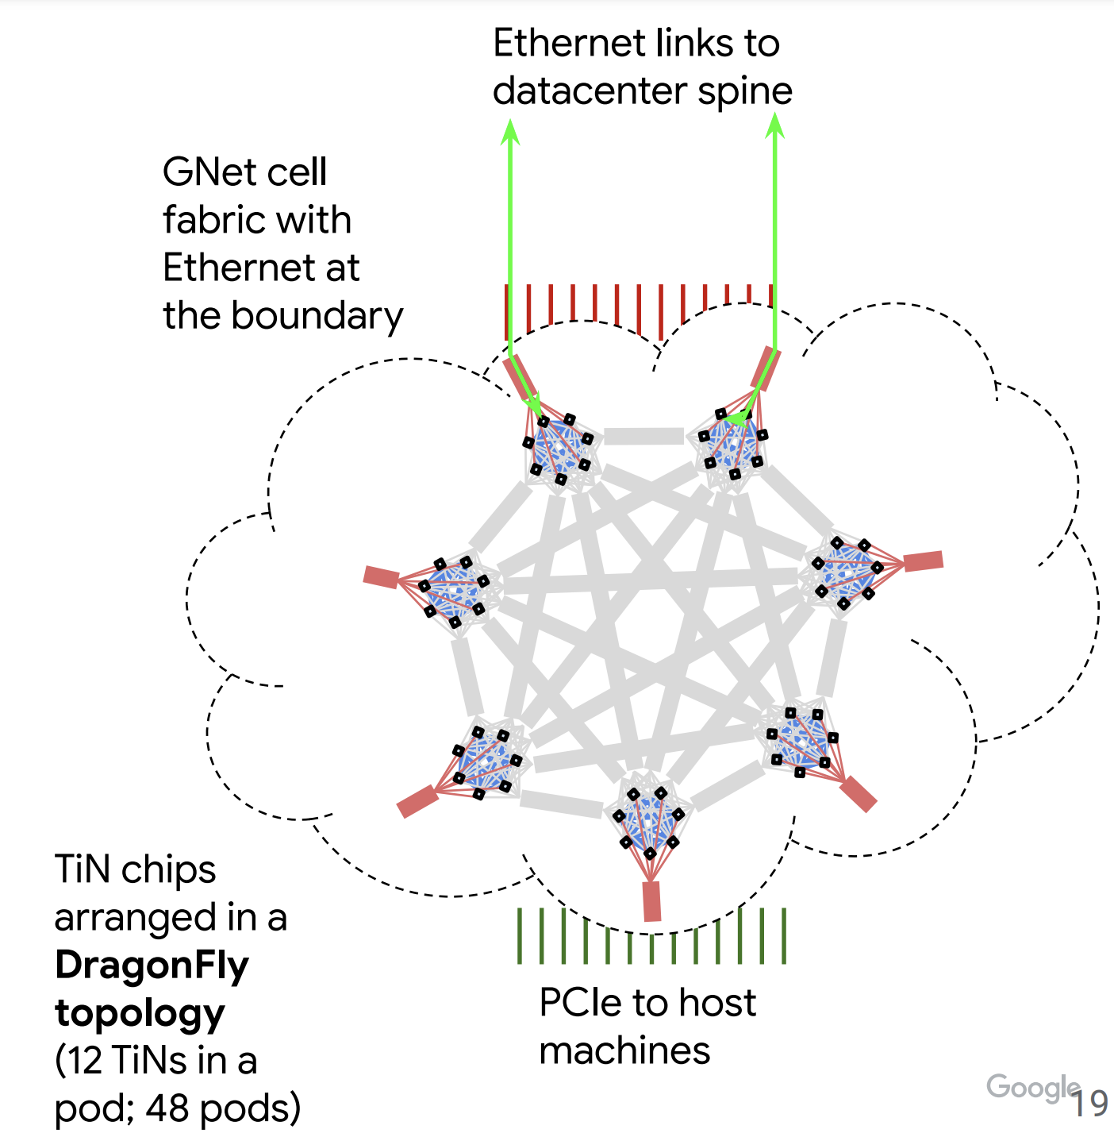
Logical Layout
Set of TiNs form a pod (rack)
Set of pods, an Aquila clique

Slide 18
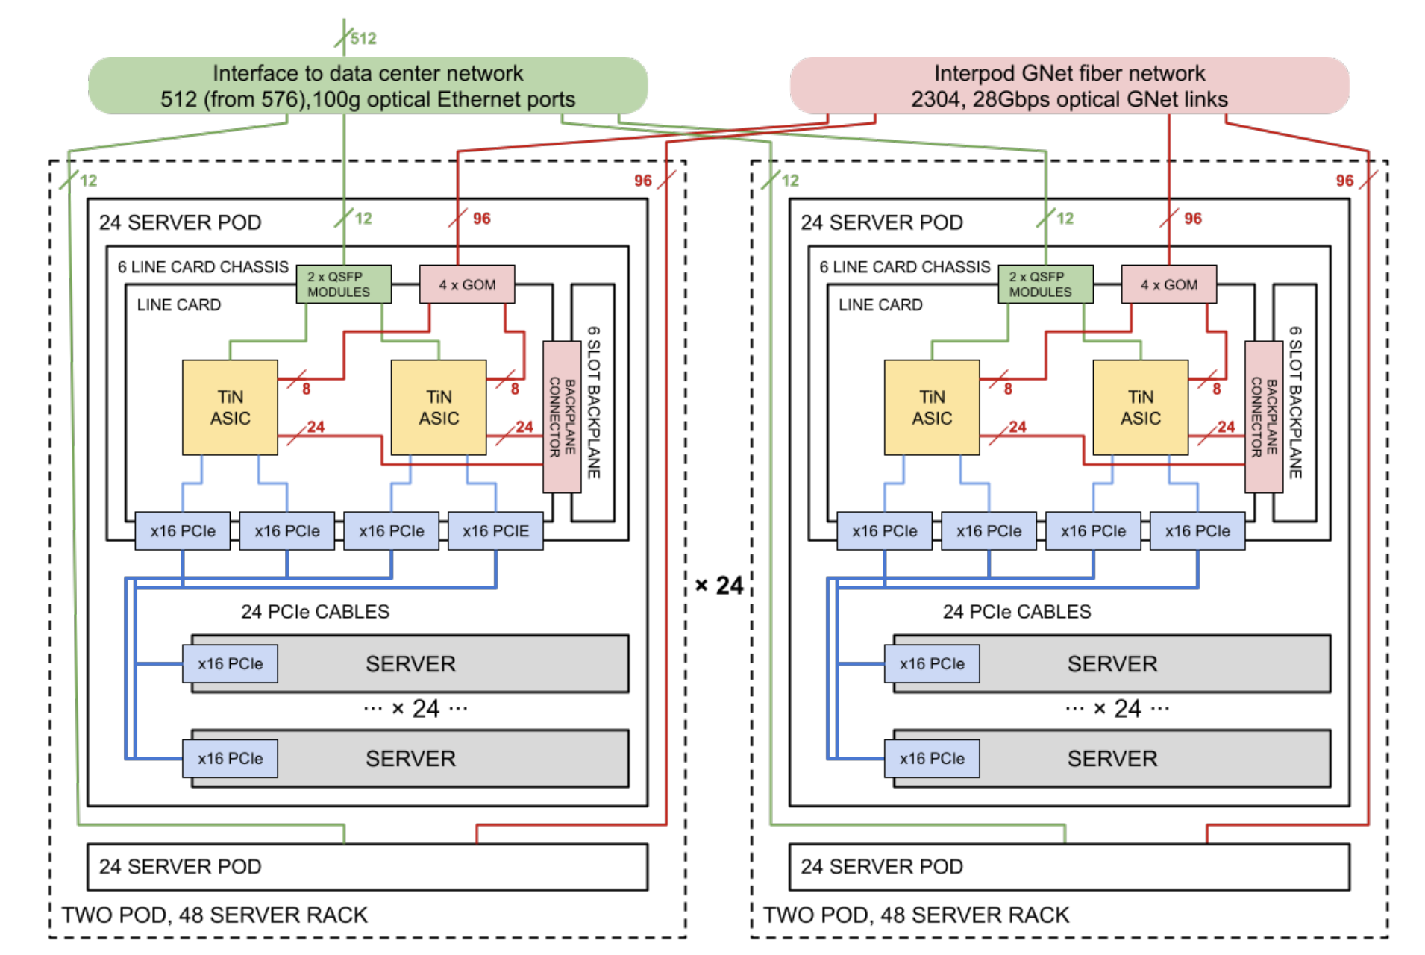
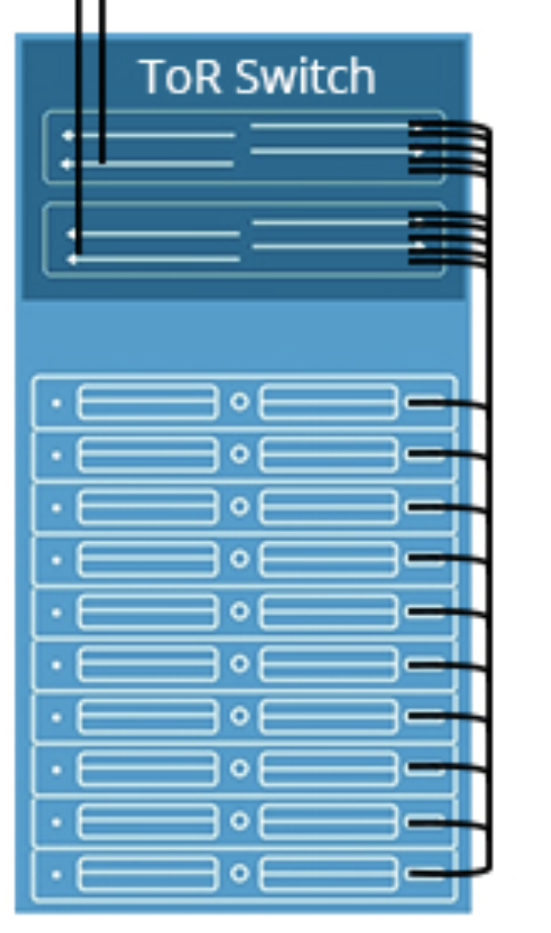
Physical Layout

Slide 19
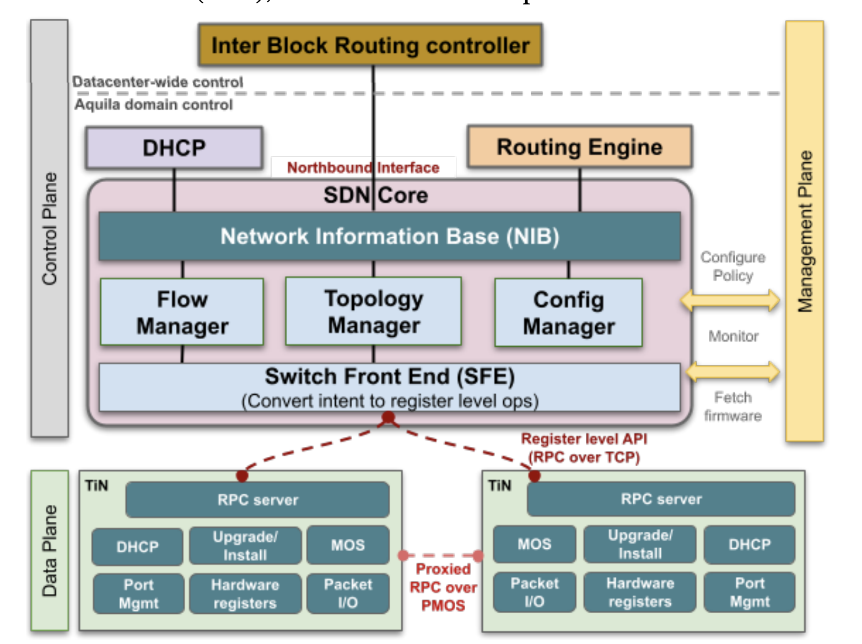
SDN Infrastructure
Centralized Control Plane
Aquila-wide controller
Embedded Control Processor
In each TiN
Wimpy for cost reasons
Exposes low-level register API
Notes:
The TiN chip has an embedded control processor (ECP) to handle all switch side control and monitoring actions. Cost of silicon exerts pressure to make the ECP as simple as possible, as it is replicated in each TiN chip. Where a typical control processor for a ToR might be a multicore, 64-bit processor with 8-16 GB of memory, TiN’s ECP is a 32-bit ARM Cortex M7 processor with a mere 2 MB of SRAM.

Slide 20
SDN Challenges for Aquila
Exploded routing state (for SDN controller)
Large number of endpoints and routing tables
Hierarchical naming and pruning redundant rules
Routing table in the TiN chip, what if it overflows?
Notes:
The TiN chip has an embedded control processor (ECP) to handle all switch side control and monitoring actions. Cost of silicon exerts pressure to make the ECP as simple as possible, as it is replicated in each TiN chip. Where a typical control processor for a ToR might be a multicore, 64-bit processor with 8-16 GB of memory, TiN’s ECP is a 32-bit ARM Cortex M7 processor with a mere 2 MB of SRAM.

Slide 21
SDN Challenges for Aquila
Exploded routing state
Switch firmware w/ 2MB SRAM
With FreeRTOS & lwIP net stack
Minimal functionality
Low level API to chip registers
Stateless firmware
Notes:
The TiN chip has an embedded control processor (ECP) to handle all switch side control and monitoring actions. Cost of silicon exerts pressure to make the ECP as simple as possible, as it is replicated in each TiN chip. Where a typical control processor for a ToR might be a multicore, 64-bit processor with 8-16 GB of memory, TiN’s ECP is a 32-bit ARM Cortex M7 processor with a mere 2 MB of SRAM.

Slide 22
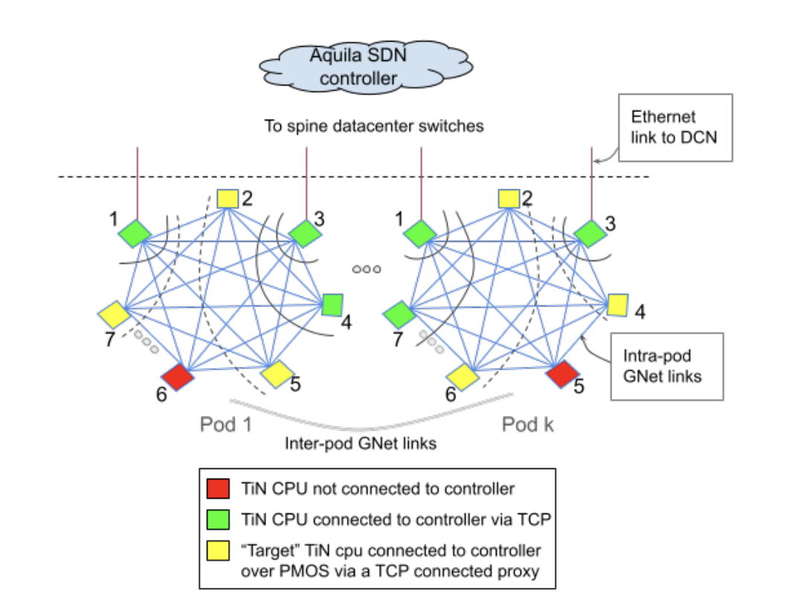
SDN Challenges for Aquila
Exploded routing state
Switch firmware w/ 2MB SRAM
In-band bootstrapping
TCP connections to TiNs in waves
Border TiNs connect first over DCN links
Other TiNs proxy through neighbors
Adjacent TiNs talk over PMOS protocol
DHCP and Control messages over GNet and PMOS
3 to 48 mins for TiN bootstrap
Notes:
The TiN chip has an embedded control processor (ECP) to handle all switch side control and monitoring actions. Cost of silicon exerts pressure to make the ECP as simple as possible, as it is replicated in each TiN chip. Where a typical control processor for a ToR might be a multicore, 64-bit processor with 8-16 GB of memory, TiN’s ECP is a 32-bit ARM Cortex M7 processor with a mere 2 MB of SRAM.

Slide 23
Evaluation
Testbed 1 Aquila Clique: 578 TiNs, 500 hosts
Apps
IP traffic generator using Pony Express [1]
CliqueMap [2]: An KV store using Pony Express or 1RMA
Both use Swift [3] Congestion Control
Metrics
IP Fabric RTT
1RMA Total Execution Latency
Achieved throughput
[1] Snap: a microkernel approach to host networking, SOSP’19
[2] CliqueMap: productionizing an RMA-based distributed caching system, SIGCOMM’21
[3] Swift: Delay is Simple and Effective for Congestion Control in the Datacenter, SIGCOMM’20

Slide 24
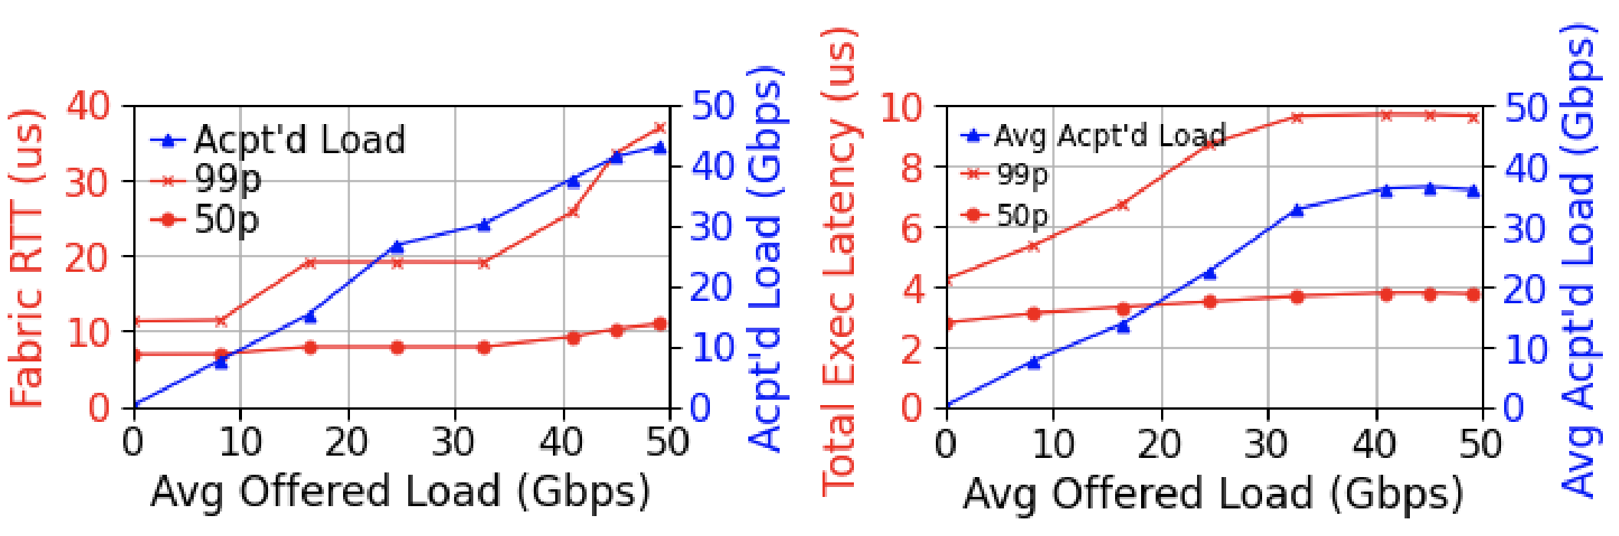
Latency under load
IP
1RMA

Slide 25
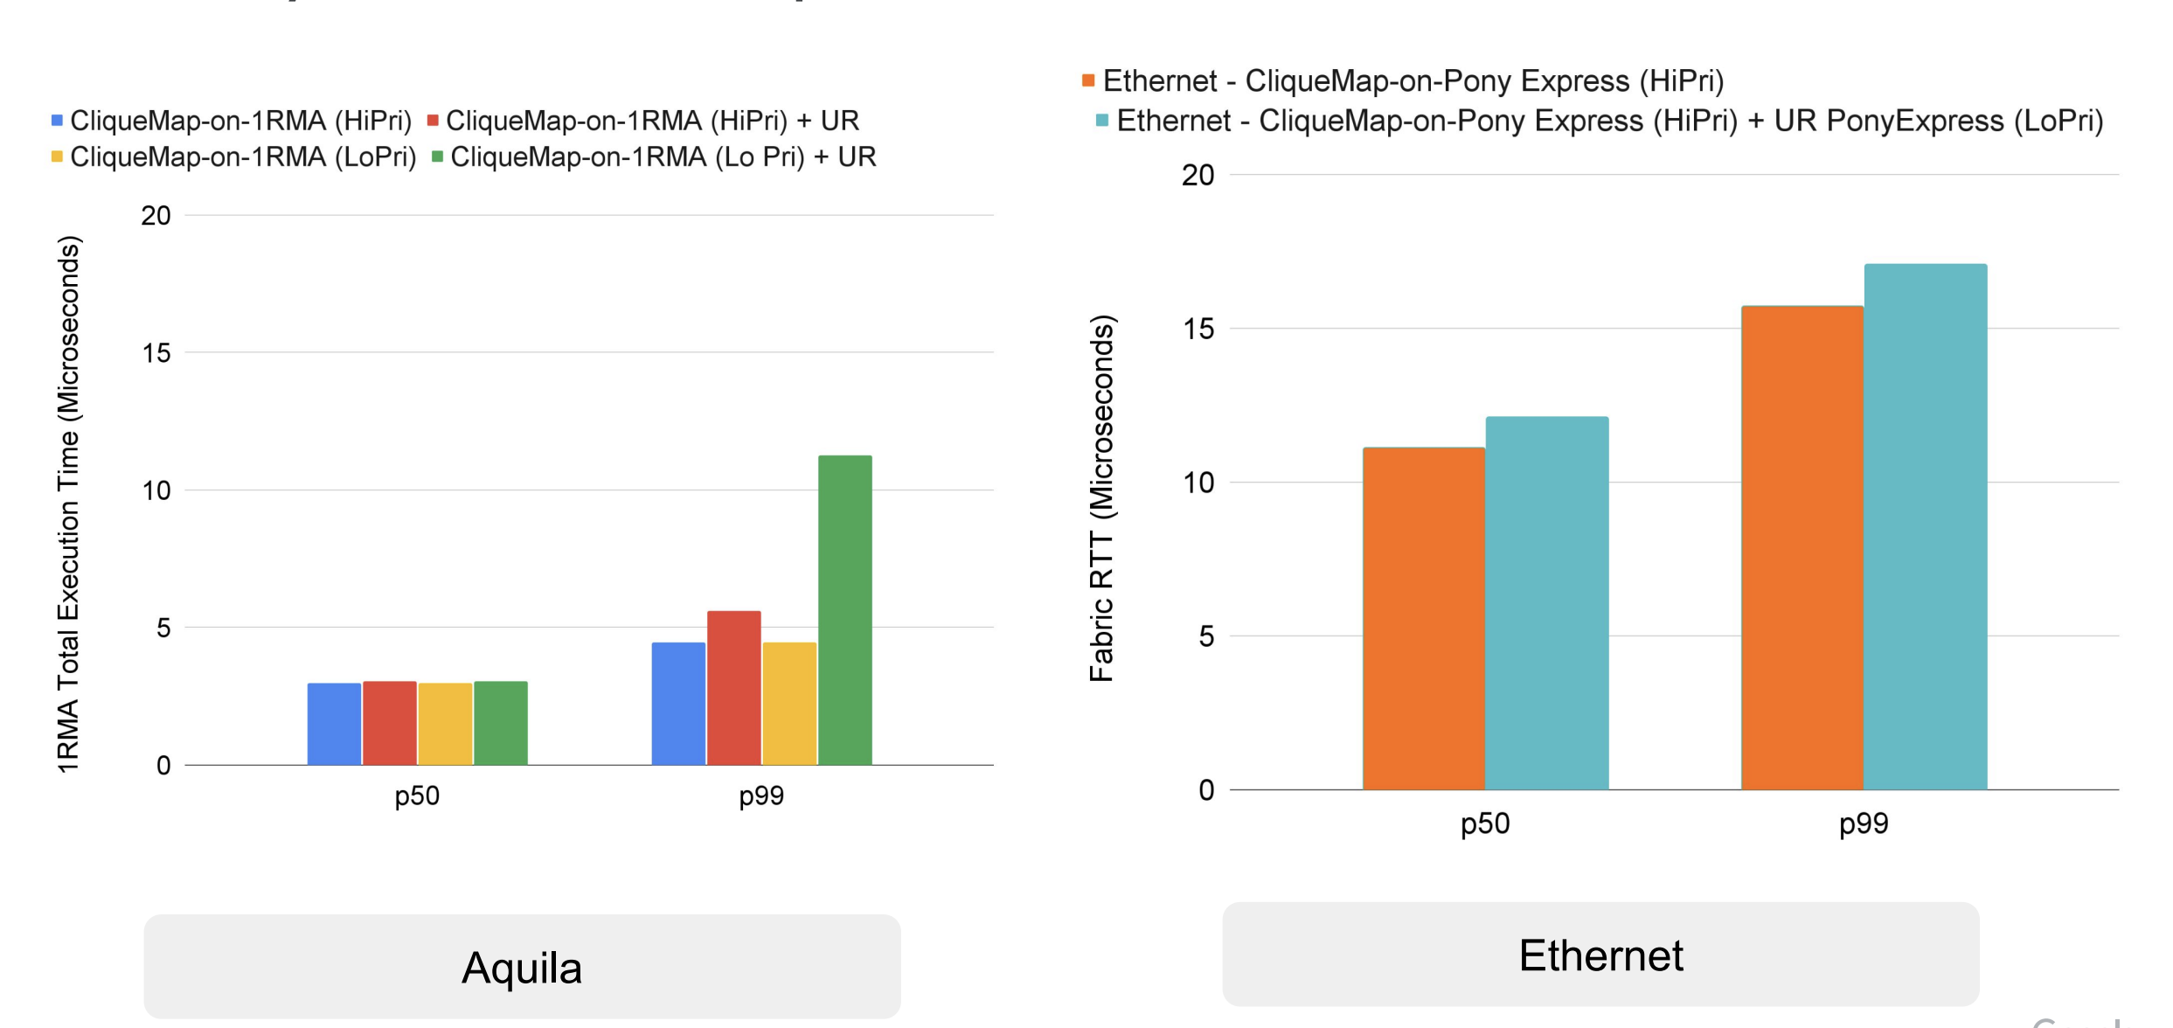
Latency Isolation

Slide 26
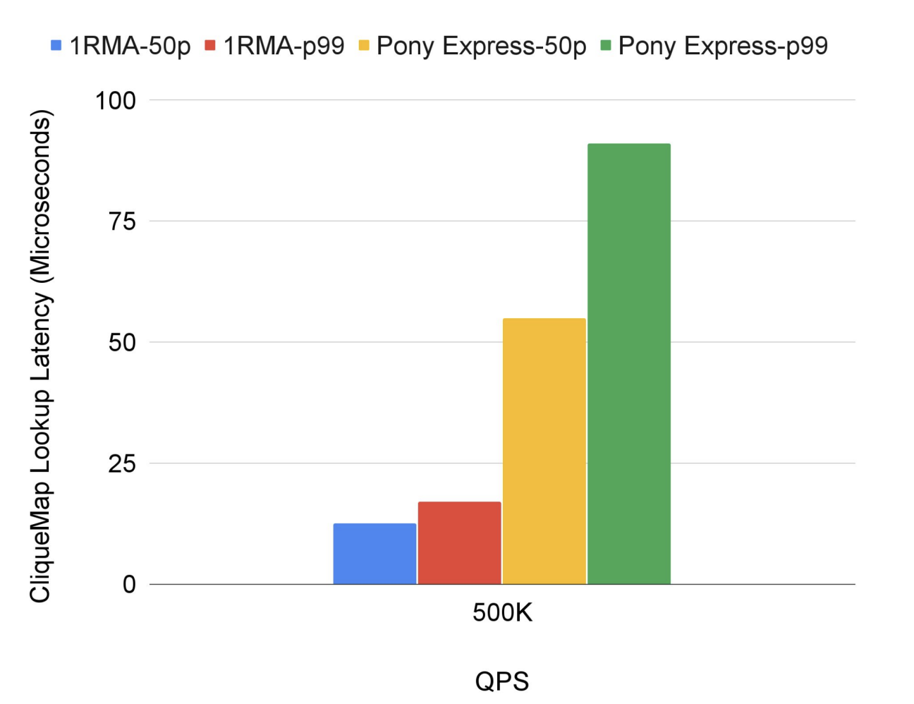
Application Impact

Slide 27
Limitations
DragonFly doesn’t allow incremental deployment (on rack scale)
Allows lesser radius
Debugging cell-switched network
No improvements for legacy applications

Slide 28
Discussion
How else could they have evaluated?

Slide 29
Aquila Summary
First attempt at DCN that supports emerging technologies at scale
Clique-scale resource disaggregation
Clique-scale ultra low-latency apps
With backwards compatibility

